Slide 1
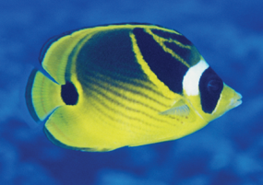
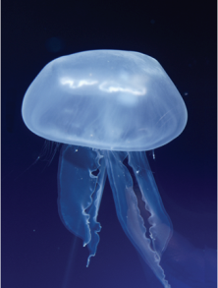
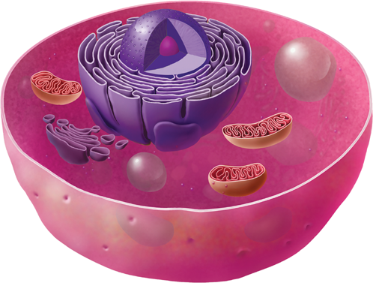

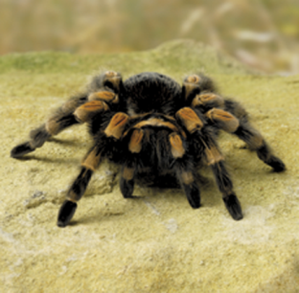
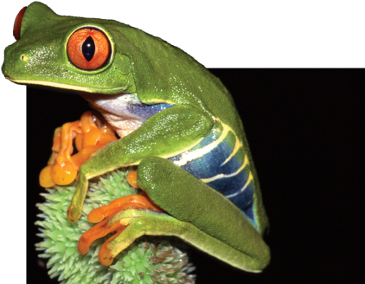
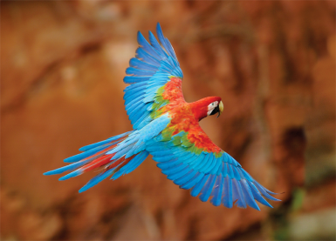
Animal Cells types
The cells of humans and other animals have a cell membrane, but they do not have a stiff cell wall. They cannot make their own food and do not have chloroplasts. However, there is a greater variety to their shapes.
Images provided by Science: A Closer Look (Maryland), Toolkit CD and page 28 (MacMillan/McGraw-Hill, 2008)

Slide 2
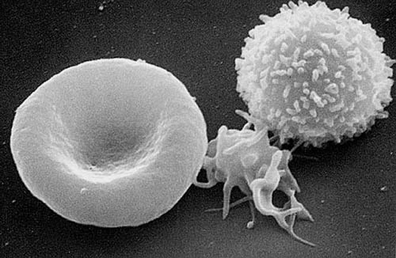
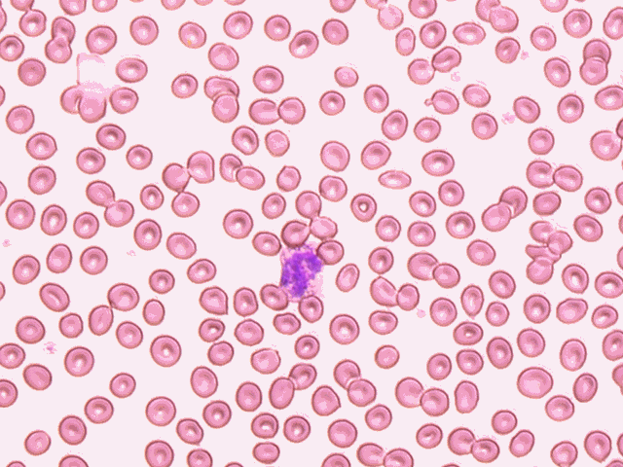
Animal Cell Example Blood Cells
are divided into different types. They
contain nucleus and some has granules.
White Blood Cell
Red Blood Cell
Red Blood Cells
Platelet
are disk-shaped, much smaller than most
other human cells and lack a nucleus
http://upload.wikimedia.org/wikipedia/commons/2/24/Red_White_Blood_cells.jpg
are very small, irregularly shaped clear cell
fragments, 2–3 µm in diameter, which derive from fragmentation of
megakaryocytes
http://upload.wikimedia.org/wikipedia/commons/e/e6/Bleeding_finger.jpg

Slide 3
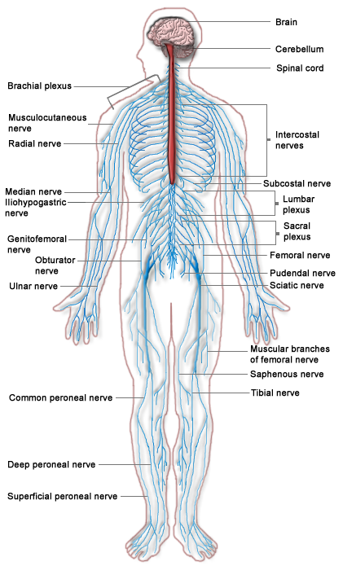
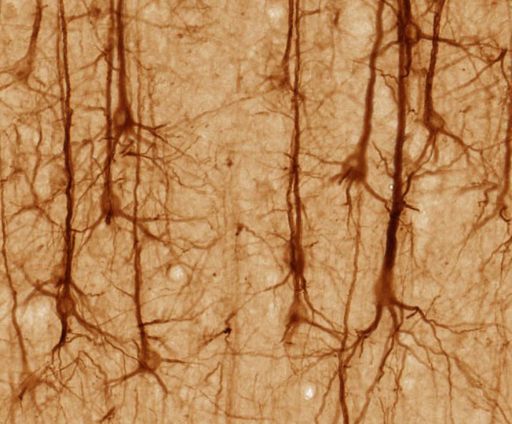
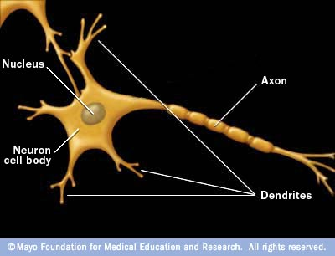
Nerve cells send signals to the brain from the body.
The long axis (main
branch) is covered in fat to prevent the electrical impulses affecting the
surrounding parts of your body.
http://upload.wikimedia.org/wikipedia/commons/b/ba/Nervous_system_diagram.png
http://en.wikipedia.org/wiki: Smi32neuron http//:brainmaps.org

Slide 4
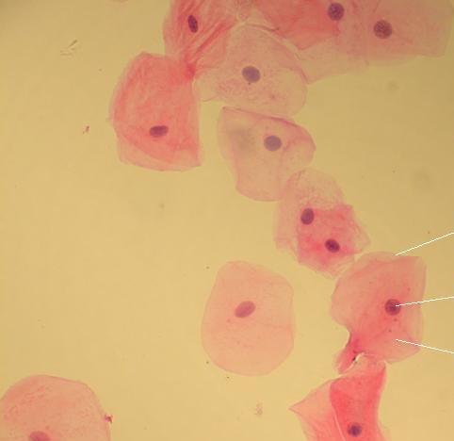

Skin (Epithelial) Cell cover the body in a thin layer. They regenerate quickly.
http://upload.wikimedia.org/wikipedia/commons/a/a9/Chica_cachetona.jpg
http://sac.edu/HomePages/nigro_dan/Cheek_cell.jpg

Slide 5
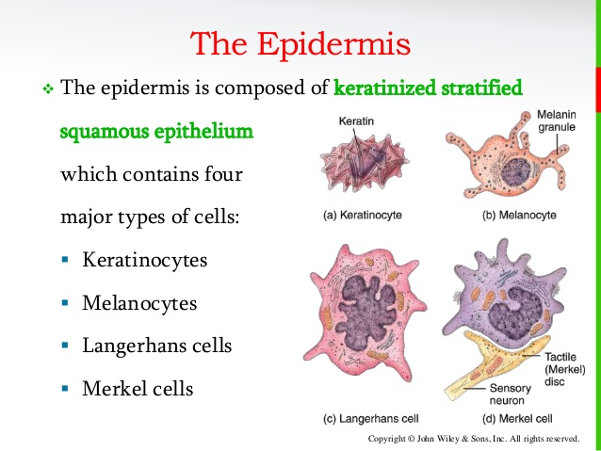
Types of skin cell in epidermis

Slide 6
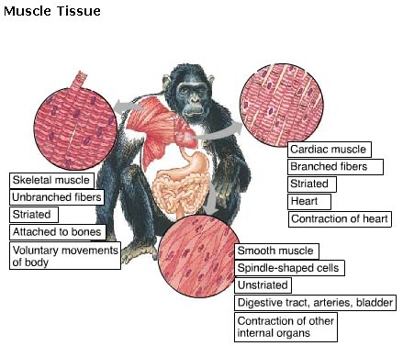
Muscle Tissue
(Movement)
Composed of long cells called muscle fibers
Contraction → movement

Slide 7
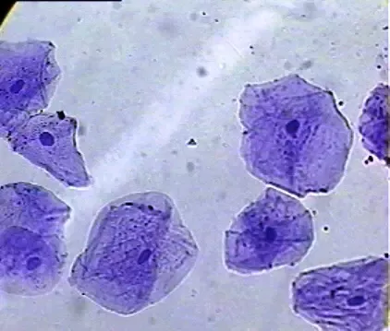
Cheek cell
Human Cheek Epithelial Cells. The tissue that lines the inside
of the mouth is known as the basal mucosa and is composed of squamous
epithelial cells. These structures, commonly thought of as cheek cells, divide
approximately every 24 hours and are constantly shed from the body

